Slide 1

Quo Vadis, Action Recognition? A New Model and the Kinetics Dataset
A STORY OF MY NOTEBOOK
Fu Yuqian
October 12, 2018
Fu Yuqian
October 12, 2018

Slide 2
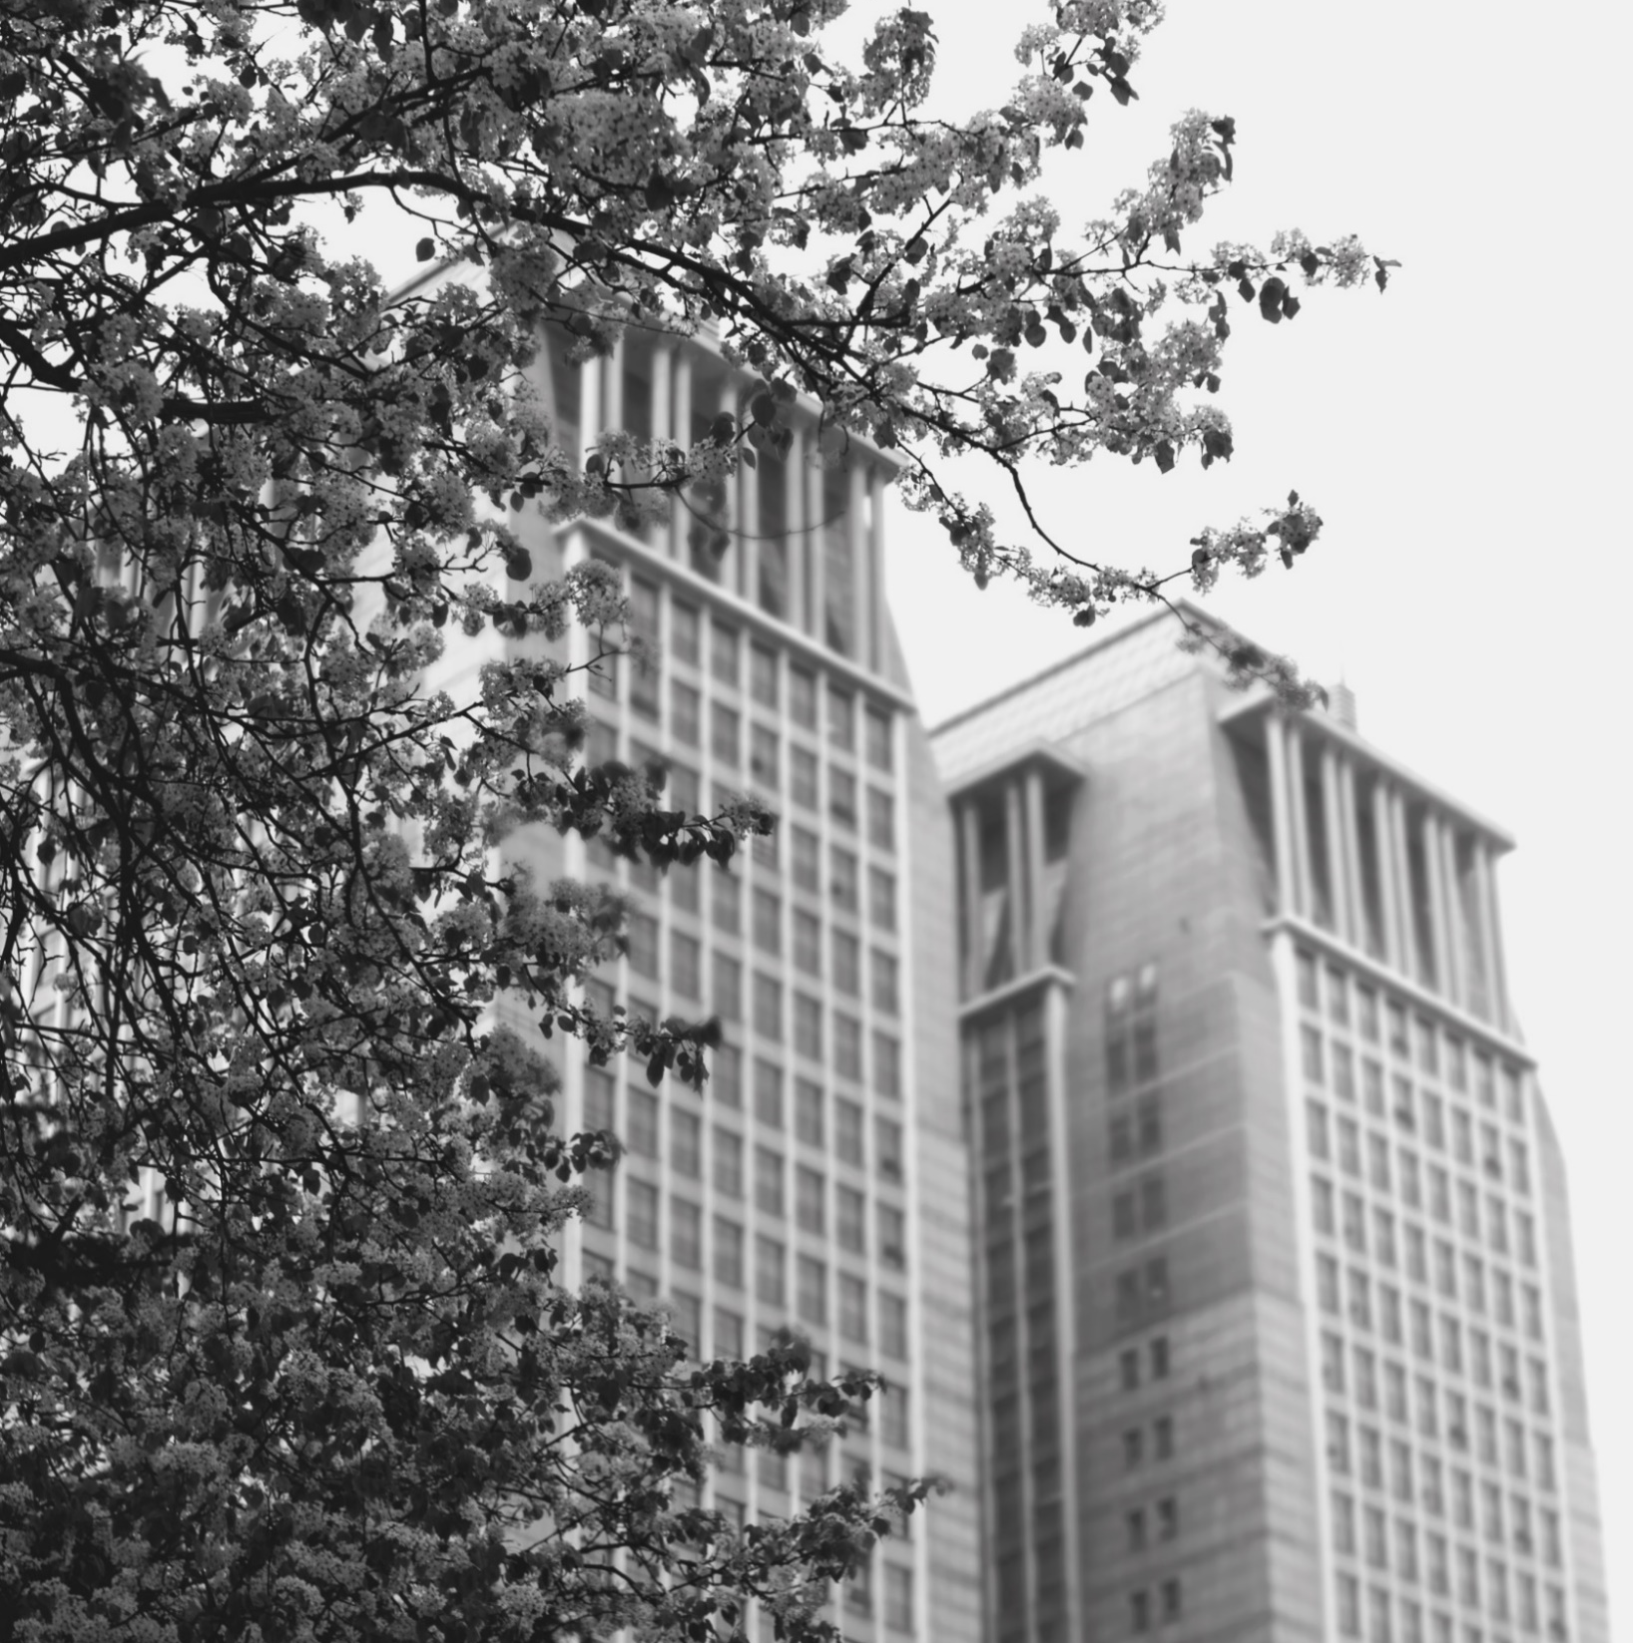
Quo Vadis
1

Slide 3
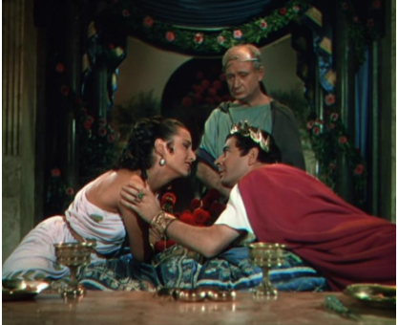
Quo Vadis，Action Recognition
What are they going to do next?
Action can be ambiguous in individual frames.
The limitations of existing action recognition datasets has meant it rely on powerful image classifiers trained on ImageNet.
A still from `Quo Vadis`
Next
Why video action recognition rely on ImageNet?
Based on this background, what has been done in this paper?

Slide 4
Introduction
2

Slide 5
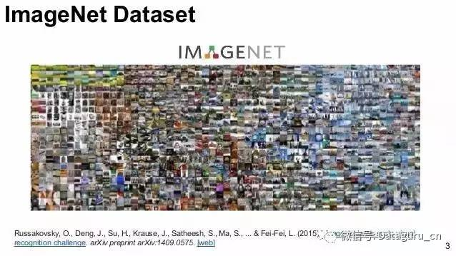
2.1 The benefits of ImageNet
ImageNet
The largest image dataset
2.2 million classes
15millon labeled images
ImageNet Challenge
Deep architecture
AlexNet，VGG-16
Warm Starting
Feature extractor

Slide 6
2.2 Inspired by ImageNet
Q
Whether training an action classification network on a sufficiently large dataset, will give a similar boost in performance when applied to different temporal task or dataset.
A
We aim to answer to this question using the new Kinetics Human Action Video Dataset.

Slide 7
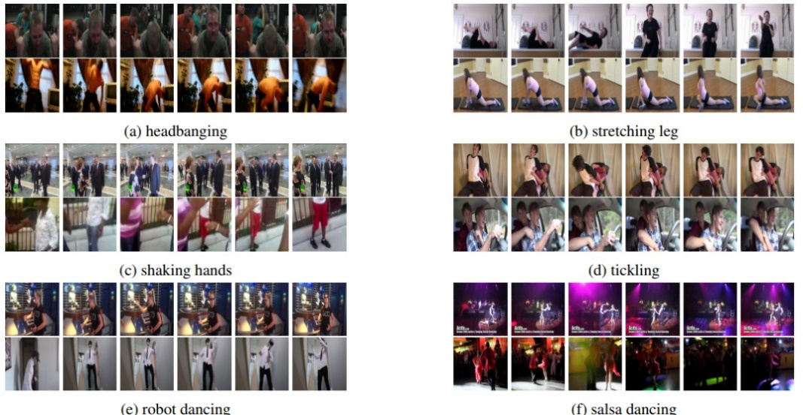
2.2 Inspired by ImageNet
KINETICS
Common action recognition datasets
HMDB-51 (51 action classes, 6849 videos)
UCF-101 (101 action classes,13320 videos)
Kinetics (400 action classes, 306245 videos)
KINETICS
400 actions, more than 400 clips for each class;
Person actions(singular): drawing, drinking, laughing;
Person-Person actions : hugging, kissing, shaking hands；
Person-Object actions : opening presents, washing dishes. moving lawn;
Some actions require temporal reasoning distinguish (different types of swimming)；
Some actions require more emphasis on the object(different types of instruments)

Slide 8
2.3 Our main contributions
1
A new training strategy
METHOD: First training video action recognition model on Kinetics and then fine-tuning each on HMDB-51 and UCF-101;
RESULT: There is always a boost in performance by pre-training, but the extent of the boost depends on the model;
2
A new model-I3D
MODEL : Based on these findings, we propose a new model“Two-Stream Inflated 3D ConvNets”(I3D);
METHOD: It builds upon state-of-art image classification model(2D), and inflates their filters and pooling kernels into 3D, leading to very deep, naturally spatio-temporal classifiers;

Slide 9
Action Recognition Architectures
3

Slide 10
3.1 Current video architectures
Major differences in current video architectures:
Whether the convolutional layers use 2D(image-based) or 3D(video-bases) kernels;
Whether the input is just RGB video or it also includes pre-computed optical flow;
In 2D ConvNets how information is propagated across frames, using LSTMs or feature aggregation ;
Some typical video recognition architectures
2D ConvNets：ConvNets with LSTMs on top；
2D ConvNets：Two-stream networks with two different stream fusion；
3D ConvNets：C3D；
Our new proposed architecture
two-stream inflated 3D ConvNets (I3D)；

Slide 11
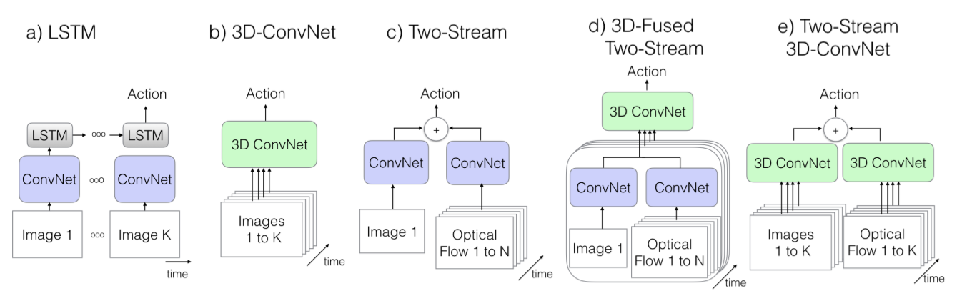
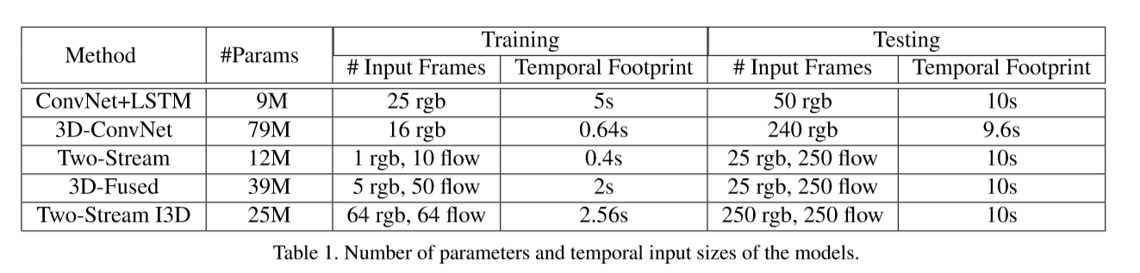
3.1 Current video architectures

Slide 12
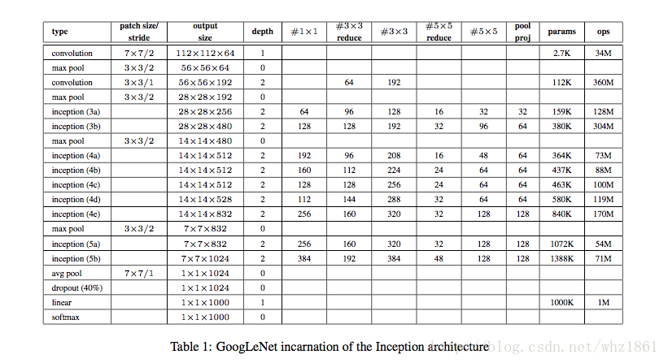
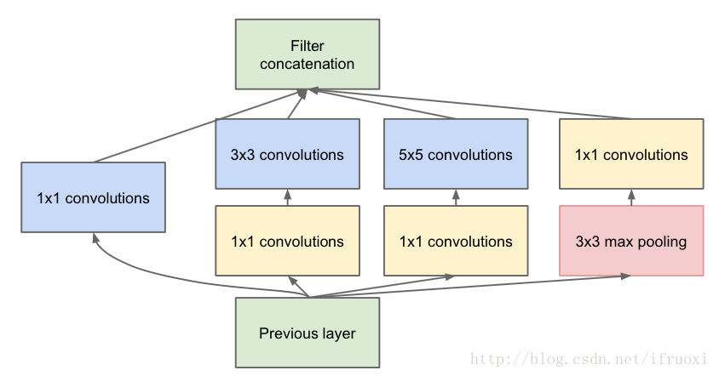
3.2 back bone of architectures
Back bone
We assumes a common ImageNet pre-trained image classification architecture as back bone；
Inception-V1 model

Slide 13
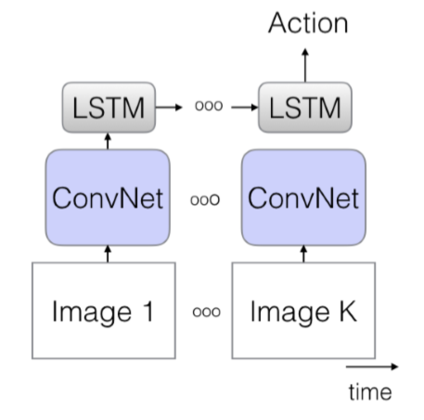
3.3 The Old 1: ConvNet+LSTM
ConvNet+LSTM architecture
LSTM layer
Capture temporal ordering and long range dependencies;
Model design
The last average pooling layer of Inception-V1 ;
LSTM layer with 512 hidden units ;
Batch normalization ;
A fully connected layer ;

Slide 14
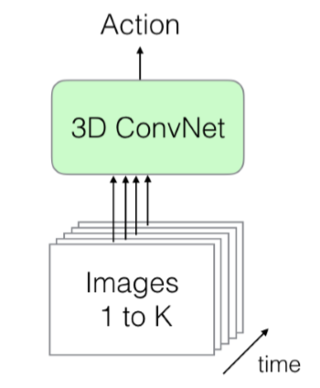
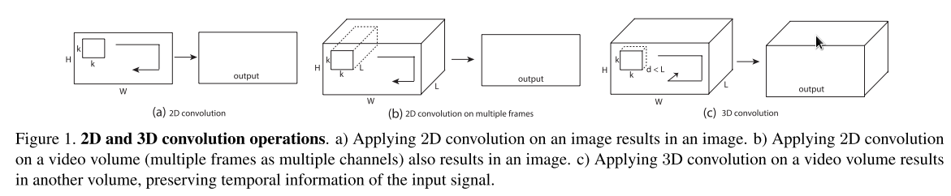
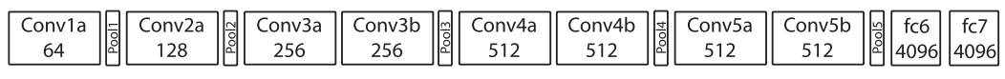
3.4 The Old 2: 3D ConvNets
3D ConvNet
2D and 3D convolutiuon operation
3D ConvNet
Seem more natural to video modeling;
Have many more parameters and harder to train;
Preclude the beneﬁts of ImageNet pre-training;
C3D architecture

Slide 15
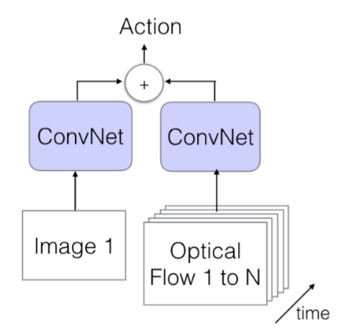
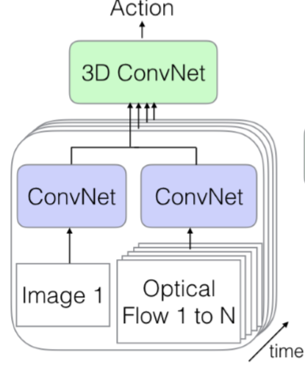
3.5 The Old 3: Two-Stream Networks
Two-Stream Networks with different fusion methods
1. why two-stream?
ConvNets + LSTMs may not capture low-level motion;
Two-stream: RGB Frames + optical flow;
2. Two different fusion methods
Fig(c): average the predictions;
Fig(d): fuses two streams using a 3D ConvNets;

Slide 16
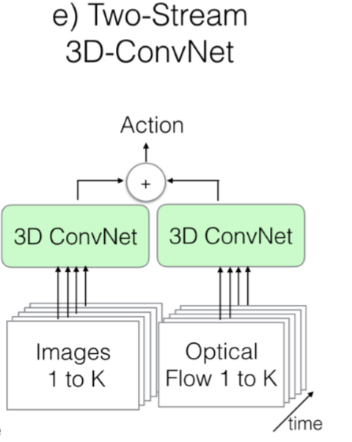
3.6 The New: Two-Stream Inflated 3D ConvNets
I3D model
1. Inflating 2D ConvNets into 3D
Convert filters and pooling kernels from square to cubic;
N*N
N*N*N
2. Bootstrapping 3D filters from 2D filters
the pooled activations on a boring-video should be the same as the original single frame;
Repeat the weights of the 2D filters(N*N) N times along time dimension;
Rescaling them by dividing by N;

Slide 17
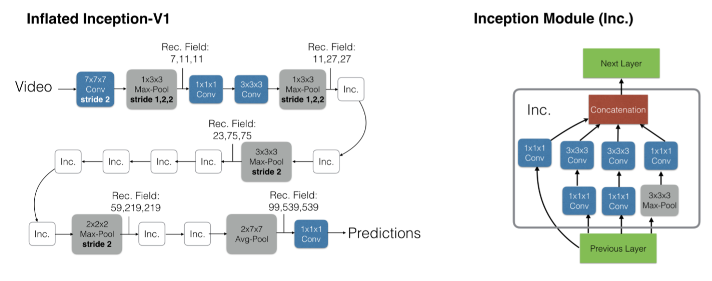
3.6 The New: Two-Stream Inflated 3D ConvNets
3. Pacing receptive field growth in space, time and network depth
convolution stride and pooling will effect feature receptive field；
A symmetric receptive ﬁeld is not necessarily optimal when also considering time , this should depend on frame rate and image dimensions.
4. Two 3D Streams

Slide 18
3.7 Implementation Details
1
Base network
2
Model layers
All models but the C3D-like 3D ConvNet use ImageNet pretrained Inception-V1 as base network;
Add a batch normalization layer and a ReLU layer to each convolutional layer, except for the last one;
3
Optimization
4
Training method
We Training five architectures using standard SGD with momentum set to 0.9 in all cases ;
We trained models on Kinetics for 110k steps, then on UCF-101 and HMDB-51 up to 5k steps ;

Slide 19
Experiments
4

Slide 20
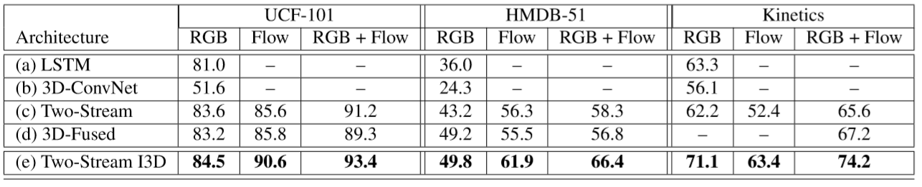
4.1 Experimental comparison of architectures
Experimental Purposes:
Compare the performance of the five architectures in the different datasets;
Experimental Data:
Experimental Results:
I3D is the best one;
UCF101 > Kinetics > HMDB-51;
Two-Stream architecture is better;

Slide 21
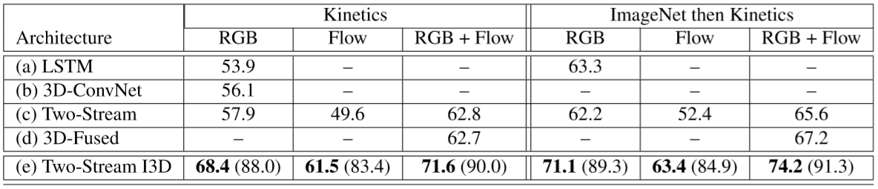
4.1 Experimental comparison of architectures
Experimental Purposes:
Examine how import it is to pre-train on ImageNet + Kinetics instead of just Kinetics;
Experimental Data:
Experimental Results:
Pretraining on ImageNet still helps;

Slide 22
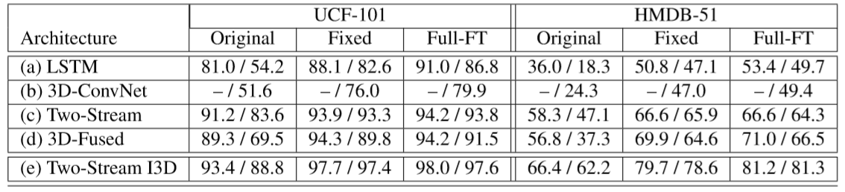
4.2 Experimental evaluation of features
Experimental Purposes:
Investigate the generalizability of the networks trained on Kinects;
Experimental Data:
Experimental Results:
Models trained on Kinects have good generalizability;
Pretraining on ImageNet + Kinetics is better;

Slide 23
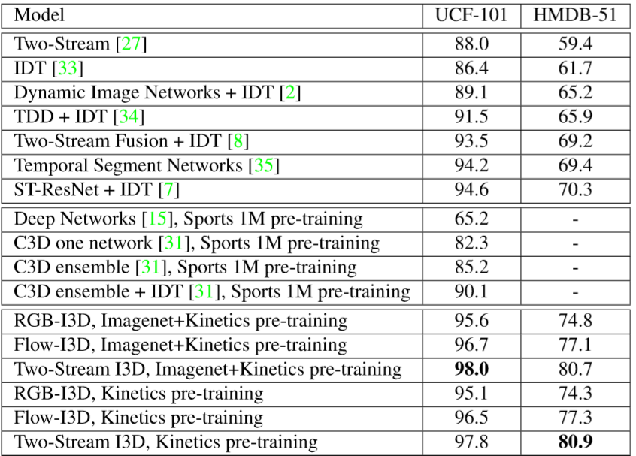
4.2 Experimental evaluation of features
Experimental Purposes:
Compare I3D with the state-of-art architectures;
Experimental Data:
Pretraining on ImageNet + Kinetics is better;

Slide 24
Discussion
5

Slide 25
Quo Vadis，Action Recognition
Is there a benefit in transfer learning from video?
Yes !
A still from `Quo Vadis`

Slide 26
THANKS

